Slide 1
Induction and Recursion
Chapter 5

Slide 2
Chapter Summary
Mathematical Induction
Strong Induction
Well-Ordering
Recursive Definitions
Structural Induction
Recursive Algorithms (omit)
Program Correctness (omit)

Slide 3
Section 5.1: Mathematical Induction
Mathematical Induction
Examples of Proof by Mathematical Induction
Mistaken Proofs by Mathematical Induction
Guidelines for Proofs by Mathematical Induction

Slide 4
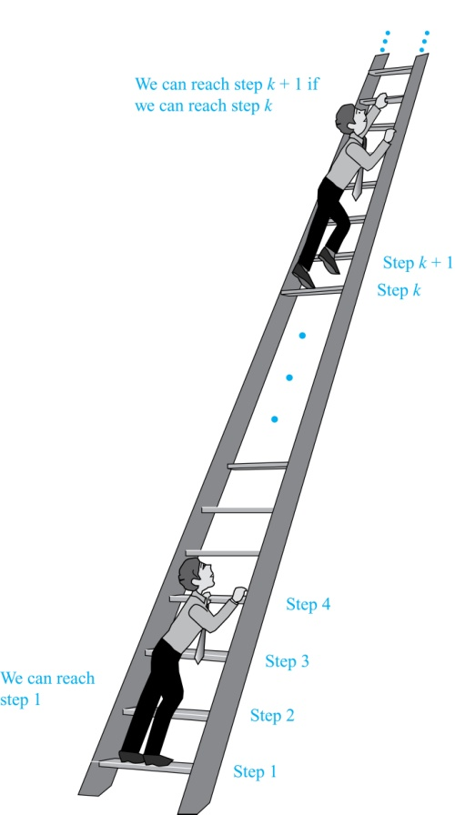
Climbing an Infinite Ladder
Suppose we have an infinite ladder:
We can reach the first rung of the ladder.
If we can reach a particular rung of the ladder, then we can reach the next rung.
From (1), we can reach the first rung. Then by applying (2), we can reach the second rung. Applying (2) again, we can reach the third rung and so on. We can apply (2) any number of times to reach any particular rung, no matter how high up.
This example motivates proof by mathematical induction.

Slide 5
Principle of Mathematical Induction
Principle of Mathematical Induction: To prove that P(n) is true for all positive integers n, where P(n) is a propositional function, we complete these steps:
Basis Step: Show that P(1) is true.
Inductive Step: Show that P(k) → P(k + 1) is true for all positive integers k.
To complete the inductive step, assuming the inductive hypothesis that P(k) holds for an arbitrary integer k, show that P(k + 1) must be true.
Mathematical induction can be expressed as the rule of inference
where the domain is the set of positive integers.
(P(1) ∧ ∀k (P(k) → P(k + 1))) → ∀n P(n)

Slide 6
Principle of Mathematical Induction
Note
In a proof by mathematical induction, we don’t assume that P(k) is true for all positive integers!
Proofs by mathematical induction do not always start at the integer 1. The basis step may begin at a starting point b where b is an integer.
Example: Climbing an Infinite Ladder.
BASIS STEP: By (1), we can reach rung 1.
INDUCTIVE STEP: Assume the inductive hypothesis that we can reach rung k. Then by (2), we can reach rung k + 1.
Hence, ∀k P(k) → P(k + 1) is true for all positive integers k. We can reach every rung on the ladder.

Slide 7
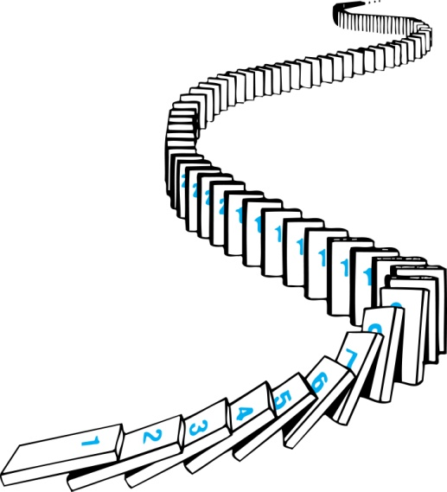
Principle of Mathematical Induction
Consider an infinite sequence of dominoes, labeled 1, 2, 3, …, where each domino is standing.
We know that the first domino is knocked down, i.e., P(1) is true .
We also know that if whenever the kth domino is knocked over, it knocks over the (k + 1)st domino, i.e, P(k) → P(k + 1) is true for all positive integers k.
Let P(n) be the proposition that the nth domino is knocked over.
Hence, all dominos are knocked over, i.e.,
P(n) is true for all positive integers n.

Slide 8
Validity of Mathematical Induction
Validity of Mathematical Induction
Suppose that P(1) holds and P(k) → P(k + 1) is true for all positive integers k.
Assume there is at least one positive integer n for which P(n) is false. Then the set S of positive integers for which P(n) is false is nonempty.
By the well-ordering property, S has a least element, say m.
We know that m can not be 1 since P(1) holds.
Since m is positive and greater than 1, m − 1 must be a positive integer. Since m − 1 < m, it is not in S, so P(m − 1) must be true.
But then, since the conditional P(k) → P(k + 1) for every positive integer k holds, P(m) must also be true. This contradicts P(m) being false.
Hence, P(n) must be true for every positive integer n.

Slide 9
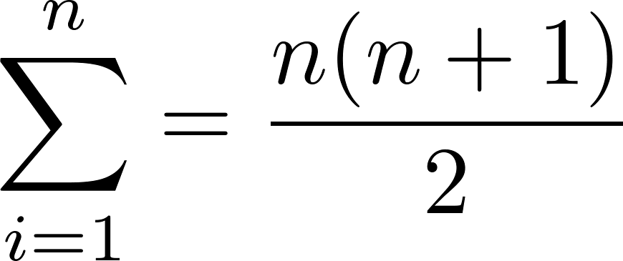
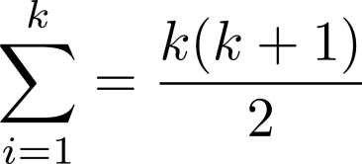
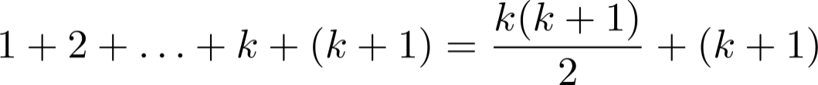
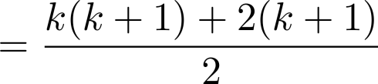
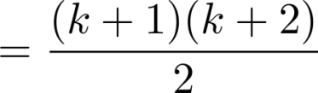
Proving Summation Formula
Example: Show that
Solution:
BASIS STEP: P(1) is true since 1(1 + 1)/2 = 1.
INDUCTIVE STEP: Assume true for P(k).
The inductive hypothesis is
Under this assumption,
i
i

Slide 10
Proving Summation Formula
Example: Conjecture and prove correct a formula for the sum of the first n positive odd integers. Then prove your conjecture.
Solution:
We have:
1= 1, 1 + 3 = 4, 1 + 3 + 5 = 9, 1 + 3 + 5 + 7 = 16, 1 + 3 + 5 + 7 + 9 = 25.
We can conjecture that the sum of the first n positive odd integers is n², i.e.,
1 + 3 + 5 + ∙∙∙+ (2n − 1) =n² .

Slide 11
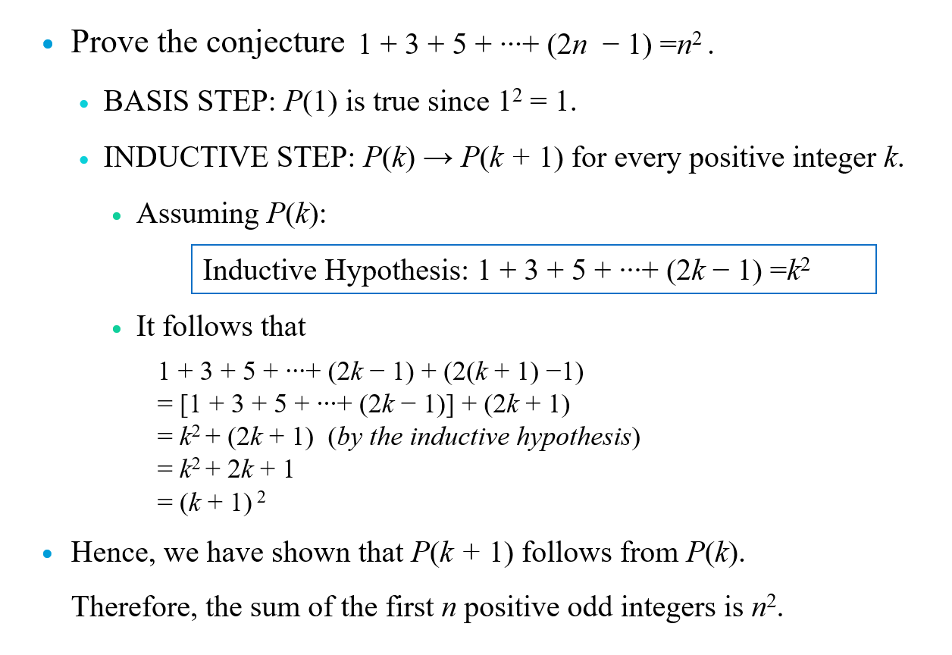
Proving Summation Formula

Slide 12
Proving Inequalities
Example: Use mathematical induction to prove that n < 2^{n} for all positive integers n.
Solution: Let P(n) be the proposition that n < 2^{n}.
BASIS STEP: P(1) is true since 1 < 2¹ = 2.
INDUCTIVE STEP:
Assume P(k) holds, i.e., k < 2^{k}, for an arbitrary positive integer k.
Must show that P(k + 1) holds. Since by the inductive hypothesis, k < 2^{k}, and 1 ≤ k < 2^{k}, it follows that:
k + 1 < 2^{k} + 1 < 2^{k} + 2^{k} = 2 ∙ 2^{k} = 2^{k+1}
Therefore n < 2^{n} holds for all positive integers n.

Slide 13
Proving Inequalities
Example: Use mathematical induction to prove that 2^{n} < n!, for every integer n ≥ 4.
Solution: Let P(n) be the proposition that 2^{n} < n!.
BASIS STEP: P(4) is true since 2⁴ = 16 < 24 =4!.
INDUCTIVE STEP:
Assume P(k) holds, i.e., 2^{k} < k! for an arbitrary integer k ≥ 4.
To show that P(k + 1) holds:
2^{k+1} = 2∙2^{k}
< 2∙ k! (by the inductive hypothesis)
< (k + 1)k!
= (k + 1)!
Therefore, 2^{n} < n! holds for every integer n ≥ 4.
Note that here the basis step is P(4), since P(0), P(1), P(2), and P(3) are all false.

Slide 14
Proving Divisibility
Example: Use mathematical induction to prove that n³ − n is divisible by 3, for every positive integer n.
Solution: Let P(n) be the proposition that n³ − n is divisible by 3.
BASIS STEP: P(1) is true since 1³ − 1 = 0, which is divisible by 3.
INDUCTIVE STEP:
Assume P(k) holds, i.e., k³ − k is divisible by 3, for an arbitrary positive integer k.
To show that P(k + 1) follows:
(k + 1)³ − (k + 1) = (k³ + 3k² + 3k + 1) − (k + 1)
= (k³ − k) + 3(k² + k)
By the inductive hypothesis, the first term (k³ − k) is divisible by 3 and the second term is divisible by 3.
By part (i) of Theorem 1 in Section 4.1 , (k + 1)³ − (k + 1) is divisible by 3.
Therefore, n³ − n is divisible by 3, for every integer positive integer n.

Slide 15
Proving Number of Subsets
Example: Use mathematical induction to show that if S is a finite set with n elements, where n is a nonnegative integer, then S has 2^{n} subsets.
Chapter 6 uses combinatorial methods to prove this result.
Solution: Let P(n) be the proposition that a set with n elements has 2^{n} subsets.
Basis Step: P(0) is true, because the empty set has only itself as a subset and 2⁰ = 1.
Inductive Step: Assume P(k) is true for an arbitrary nonnegative integer k.

Slide 16
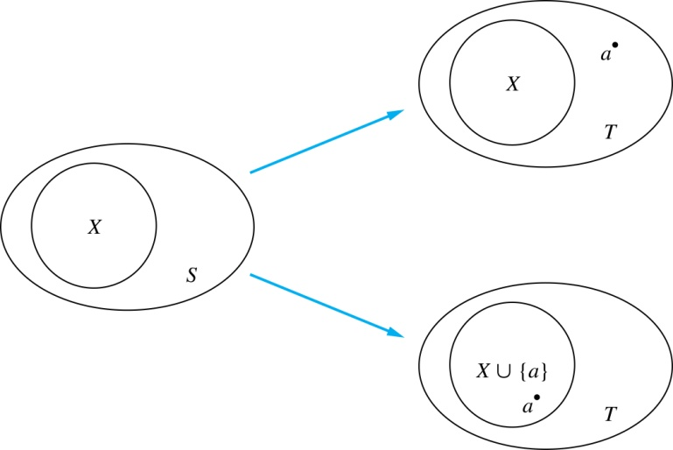
Proving Number of Subsets
Inductive Hypothesis: For an arbitrary nonnegative integer k, every set with k elements has 2^{k} subsets.
Let T be a set with k + 1 elements. Then T = S ∪ {a}, where a ∈ T and S = T − {a}. Hence |S| = k.
For each subset X of S, there are exactly two subsets of T, i.e., X and X ∪ {a}.
By the inductive hypothesis, S has 2^{k} subsets. Since there are two subsets of T for each subset of S, the number of subsets of T is 2 ∙2^{k} = 2^{k+1} .

Slide 17



Proving Tiling of Checkerboards
Example: Show that every 2^{n} × 2^{n} checkerboard with one square removed can be tiled using right triominoes.
Solution: Let P(n) be the proposition that every 2^{n} ×2^{n} checkerboard with one square removed can be tiled using right triominoes.
BASIS STEP: P(1) is true, because each of the four 2 ×2 checkerboards with one square removed can be tiled using one right triomino.
INDUCTIVE STEP: Assume that P(k) is true for every 2^{k} ×2^{k} checkerboard, for some positive integer k.
Each covers three squares

Slide 18
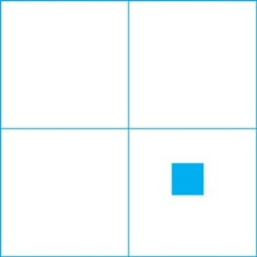

Proving Tiling of Checkerboards
Inductive Hypothesis: Every 2^{k} × 2^{k} checkerboard, for some positive integer k, with one square removed can be tiled using right triominoes.
Consider a 2^{k+1} × 2^{k+1} checkerboard with one square removed. Split this checkerboard into four checkerboards of size 2^{k} × 2^{k}, by dividing it in half in both directions.
Remove a square from one of the four 2^{k} × 2^{k} checkerboards. By the inductive hypothesis, this board can be tiled. Also by the inductive hypothesis, the other three boards can be tiled with the square from the corner of the center of the original board removed. We can then cover the three adjacent squares with a triominoe.
Hence, the entire 2^{k+1} × 2^{k+1} checkerboard with one square removed can be tiled using right triominoes.

Slide 19
Incorrect “Proof” by Mathematical Induction
Example: Let P(n) be the statement that every set of n lines in the plane, no two of which are parallel, meet in a common point. Here is a “proof” that P(n) is true for all positive integers n ≥ 2.
BASIS STEP: The statement P(2) is true because any two lines in the plane that are not parallel meet in a common point.
INDUCTIVE STEP: The inductive hypothesis is the statement that P(k) is true for the positive integer k ≥ 2, i.e., every set of k lines in the plane, no two of which are parallel, meet in a common point.
We must show that if P(k) holds, then P(k + 1) holds, i.e., if every set of k lines in the plane, no two of which are parallel, k ≥ 2, meet in a common point, then every set of k + 1 lines in the plane, no two of which are parallel, meet in a common point.

Slide 20
Incorrect “Proof” by Mathematical Induction
Inductive Hypothesis: Every set of k lines in the plane, where k ≥ 2, no two of which are parallel, meet in a common point.
Consider a set of k + 1 distinct lines in the plane, no two parallel. By the inductive hypothesis, the first k of these lines must meet in a common point p₁, and the last k of these lines meet in a common point p₂.
If p₁ and p₂ are different points, all lines containing both of them must be the same line since two points determine a line. This contradicts the assumption that the lines are distinct. Hence, p₁ = p₂ lies on all k + 1 distinct lines, and thus P(k + 1) holds. Therefore, P(n) is true for all positive integers n ≥ 2.
There must be an error in this proof since the conclusion is absurd.
P(k)→ P(k + 1) does NOT hold for k = 2, i.e., it is NOT the case that P(2) implies P(3). The first two lines must meet in a common point p₁ and the second two must meet in a common point p₂. They do NOT have to be the same point since only the second line is common to both sets of lines.
Note that P(3) is false.
Wrong!

Slide 21
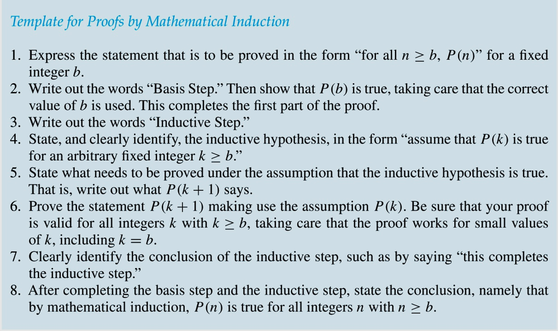
Guidelines for Mathematical Induction Proofs

Slide 22
Section 5.2: Strong Induction and Well-Ordering
Strong Induction
Example Proofs using Strong Induction
Well-Ordering Property

Slide 23
Strong Induction
Strong Induction: To prove that P(n) is true for all positive integers n, where P(n) is a propositional function, complete two steps:
Basis Step: Verify that the proposition P(1) is true.
Inductive Step: Show the conditional statement [P(1) ∧ P(2) ∧∙∙∙ ∧ P(k)] → P(k + 1) holds for all positive integers k.
Strong Induction is sometimes called the second principle of mathematical induction or complete induction.

Slide 24
Strong Induction
Strong induction tells us that we can reach all rungs if:
We can reach the first rung of the ladder.
For every integer k, if we can reach the first k rungs, then we can reach the (k + 1)st rung.
To conclude that we can reach every rung by strong induction:
BASIS STEP: P(1) holds
INDUCTIVE STEP: Assume P(1) ∧ P(2) ∧∙∙∙ ∧ (k) holds for an arbitrary integer k, and show that P(k + 1) must also hold.
We will show by strong induction that for every positive integer n, P(n) holds, i.e., we can
reach the nth rung of the ladder.

Slide 25
Strong Induction
Example: Suppose we can reach the first and second rungs of an infinite ladder, and we know that if we can reach a rung, then we can reach two rungs higher. Prove that we can reach every rung.
Mathematical Induction cannot prove it.
Using Strong Induction
BASIS STEP: We can reach the first rung and the second rung.
INDUCTIVE STEP: The inductive hypothesis is that we can reach the first k rungs, for any k ≥ 2. We can reach the (k + 1)st rung since we can reach the (k − 1)st rung by the inductive hypothesis.
Hence, we can reach all rungs of the ladder.

Slide 26
Strong Induction
Example: Show that if n is an integer greater than 1, then n can be written as the product of primes.
Let P(n) be the proposition that n can be written as a product of primes.
BASIS STEP: P(2) is true since 2 itself is prime.
INDUCTIVE STEP: The inductive hypothesis is P(j) is true for all integers j with 2 ≤ j ≤ k. To show that P(k + 1) must be true, two cases need to be considered:
If k + 1 is prime, then P(k + 1) is true.
Otherwise, k + 1 is composite and can be written as the product of two positive integers a and b with 2 ≤ a ≤ b < k + 1. By the inductive hypothesis a and b can be written as the product of primes and therefore k + 1 can also be written as the product of those primes.
Hence, every integer greater than 1 can be written as the product of primes.

Slide 27
Which Form of Induction Should Be Used?
We can always use strong induction instead of mathematical induction.
But there is no reason to use it if it is simpler to use mathematical induction.
In fact, the principles of mathematical induction, strong induction, and the well-ordering property are all equivalent.
Sometimes it is clear how to proceed using one of the three methods, but not the other two.

Slide 28
Postage Problem
Prove that every amount of postage of 12 cents or more can be formed using just 4-cent and 5-cent stamps by using Mathematical Induction.
Let P(n) be the proposition that postage of n cents can be formed using 4-cent and 5-cent stamps.
BASIS STEP: Postage of 12 cents can be formed using three 4-cent stamps.
INDUCTIVE STEP: The inductive hypothesis P(k) for any positive integer k is that postage of k cents can be formed using 4-cent and 5-cent stamps. To show P(k + 1) where k ≥ 12, we consider two cases:
If at least one 4-cent stamp has been used, then a 4-cent stamp can be replaced with a 5-cent stamp to yield a total of k + 1 cents.
Otherwise, at least three 5-cent stamps were used. Three 5-cent stamps can be replaced by four 4-cent stamps to yield a total of k + 1 cents.
Hence, P(n) holds for all n ≥ 12.

Slide 29
Postage Problem
Prove that every amount of postage of 12 cents or more can be formed using just 4-cent and 5-cent stamps by using Strong Induction.
Let P(n) be the proposition that postage of n cents can be formed using 4-cent and 5-cent stamps.
BASIS STEP: P(12), P(13), P(14), and P(15) hold.
P(12) uses three 4-cent stamps.
P(13) uses two 4-cent stamps and one 5-cent stamp.
P(14) uses one 4-cent stamp and two 5-cent stamps.
P(15) uses three 5-cent stamps.
INDUCTIVE STEP: Assume the inductive hypothesis that P(j) holds for 12 ≤ j ≤ k, where k ≥ 15. It can be shown that P(k + 1) holds.
Using the inductive hypothesis, P(k − 3) holds since k − 3 ≥ 12. To form postage of k + 1 cents, add a 4-cent stamp to the postage for k − 3 cents.
Hence, P(n) holds for all n ≥ 12.

Slide 30
Well-Ordering Property
Well-ordering property: Every nonempty set of nonnegative integers has a least element.
The well-ordering property is one of the axioms of the positive integers listed in Appendix 1.
The well-ordering property can be used directly in proofs, as the next example illustrates.
The well-ordering property can be generalized.
Definition: A set is well ordered if every subset has a least element.
N is well ordered under ≤.
The set of finite strings over an alphabet using lexicographic ordering is well ordered.

Slide 31
Section 5.3: Recursive Definitions and Structural Induction
Recursively Defined Functions
Recursively Defined Sets and Structures
Structural Induction
Generalized Induction

Slide 32
Recursively Defined Functions
Definition: A recursive or inductive definition of a function consists of two steps.
BASIS STEP: Specify the value of the function at zero.
RECURSIVE STEP: Give a rule for finding its value at an integer from its values at smaller integers.
Example: Give a recursive definition of the factorial function n!:
f(0) = 1
f(n + 1) = (n + 1)∙ f(n)

Slide 33
Recursively Defined Functions
Example: Suppose f is defined by:
f(0) = 3,
f(n + 1) = 2f(n) + 3
Find f(1), f(2), f(3), f(4)
Solution:
f(1) = 2f(0) + 3 = 2∙3 + 3 = 9
f(2) = 2f(1)+ 3 = 2∙9 + 3 = 21
f(3) = 2f(2) + 3 = 2∙21 + 3 = 45
f(4) = 2f(3) + 3 = 2∙45 + 3 = 93

Slide 34
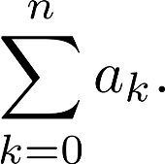
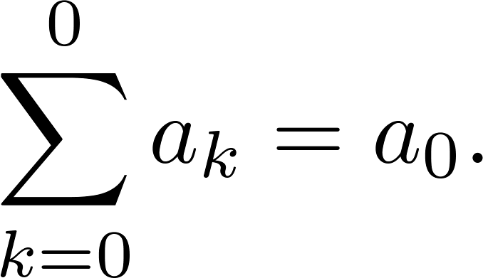
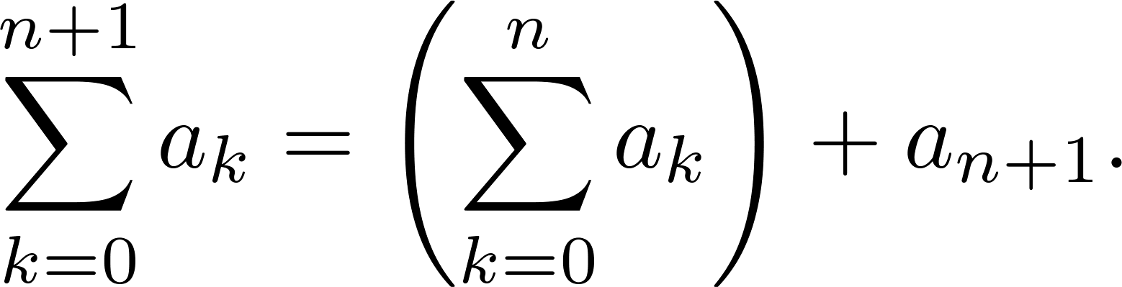
Recursively Defined Functions
Example: Give a recursive definition of:
The first part of the definition is
The second part is

Slide 35
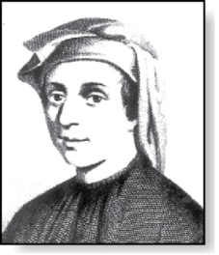
Fibonacci Numbers
Fibonacci
(1170- 1250) Italy
Example: The Fibonacci numbers are defined as follows:
f₀ = 0
f₁ = 1
f_{n} = f_{n−1} + f_{n−2} for n ≥ 2
Find f₂, f₃ , f₄ , f₅ .
f₂ = f₁ + f₀ = 1 + 0 = 1
f₃ = f₂ + f₁ = 1 + 1 = 2
f₄ = f₃ + f₂ = 2 + 1 = 3
f₅ = f₄ + f₃ = 3 + 2 = 5

Slide 36
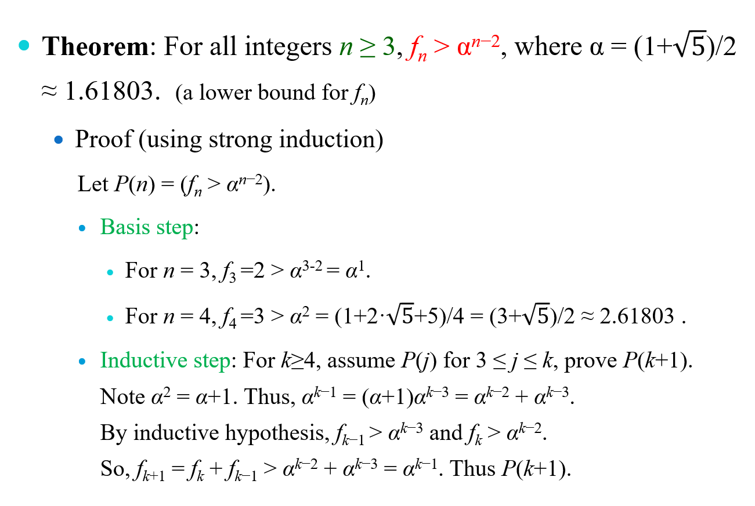
Fibonacci Numbers

Slide 37
Recursively Defined Sets and Structures
Recursive definitions of sets have two parts:
The basis step specifies an initial collection of elements.
The recursive step gives the rules for forming new elements in the set from those already known to be in the set.
We will always assume that the exclusion rule holds, even if it is not explicitly mentioned.
Exclusion rule specifies that the set contains nothing other than those elements specified in the basis step and generated by applications of the rules in the recursive step.

Slide 38
Recursively Defined Sets and Structures
Example: Subset of Integers S recursively defined by:
BASIS STEP: 3 ∊ S.
RECURSIVE STEP: If x ∊ S and y ∊ S, then x + y ∊ S.
Initially 3 is in S, then 3 + 3 = 6, then 3 + 6 = 9, etc.
Example: The natural numbers N.
BASIS STEP: 0 ∊ N.
RECURSIVE STEP: If n is in N, then n + 1 is in N.
Initially 0 is in S, then 0 + 1 = 1, then 1 + 1 = 2, etc.

Slide 39
Strings
Definition: The set Σ* of strings over the alphabet Σ:
BASIS STEP: λ ∊ Σ* (λ is the empty string)
RECURSIVE STEP: If w ∊ Σ* and x ∊ Σ, then wx ∈ Σ*.
Example: If Σ = {0, 1}, the strings in Σ* are the set of all bit strings, λ, 0, 1, 00, 01, 10, 11, etc.
Example: If Σ = {a, b}, show that aab is in Σ*.
Since λ ∊ Σ* and a ∊ Σ, a ∊ Σ*.
Since a ∊ Σ* and a ∊ Σ, aa ∊ Σ*.
Since aa ∊ Σ* and b ∊ Σ, aab ∊ Σ*.

Slide 40
String Concatenation
Definition: Let Σ be a set of symbols and Σ* be the set of strings formed from the symbols in Σ. We can define the concatenation of two strings, denoted by ∙ , recursively as follows.
BASIS STEP: If w ∈ Σ*, then w ∙ λ= w.
RECURSIVE STEP: If w₁ ∈ Σ* and w₂ ∈ Σ* and x ∈ Σ, then w ₁∙ (w₂ x) = (w₁ ∙ w₂)x.
Often w₁ ∙ w₂ is written as w₁ w₂.
If w₁ = abra and w₂ = cadabra, the concatenation w₁ w₂ = abracadabra.

Slide 41
Length of a String
Example: Give a recursive definition of l(w), the length of the string w.
The length of a string can be recursively defined by:
l(λ) = 0;
l(wx) = l(w) + 1 if w ∊ Σ* and x ∊ Σ.
Example: Find the length of the string “test” by the above recursive definition of the length of string.
l(test) = l(tes) + 1 = l(te) + 2 = l(t) + 3 = l(λ) + 4 = 0 + 4 = 4

Slide 42
Well-Formed Formulae in Propositional Logic
Definition: The set of well-formed formulae in propositional logic involving T, F, propositional variables, and operators from the set {¬,∧,∨,→,↔}.
BASIS STEP: T, F, and s, where s is a propositional variable, are well-formed formulae.
RECURSIVE STEP: If D and E are well formed formulae, then (¬ D), (D ∧ E), (D ∨ E), (D → E), and (D ↔ E) are well-formed formulae.
Examples: ((p ∨q) → (q ∧ F)) is a well-formed formula. pq ∧ is not a well formed formula.

Slide 43
Rooted Trees
Definition: The set of rooted trees, where a rooted tree consists of a set of vertices containing a distinguished vertex root, and edges connecting these vertices, can be defined recursively by:
Basis step: A single vertex r is a rooted tree.
Recursive step: Suppose that T₁, T₂, …, T_{n} are disjoint rooted trees with roots r₁, r₂, …, r_{n}. Then, the graph formed by starting with a root r, which is not in any of the rooted trees T₁, T₂, …, T_{n}, and adding an edge from r to each of r₁, r₂, …, r_{n}, is also a rooted tree.

Slide 44
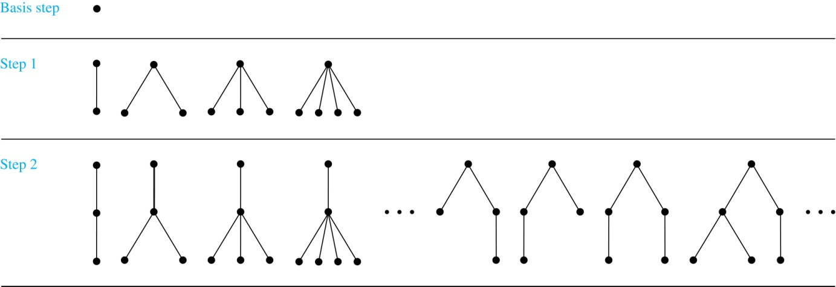
Building Up Rooted Trees
…
Note: Binary trees are a special type of rooted trees.

Slide 45
Extended Binary Trees
Definition: The set of extended binary trees can be defined recursively by:
Basis step: The empty set ∅ is an extended binary tree.
Recursive step: If T₁ and T₂ are disjoint extended binary trees, there is an extended binary tree, denoted by T₁ · T₂, consisting of a root r together with edges connecting the root to each of the roots of the left subtree T₁ and the right subtree T₂ when these trees are nonempty.

Slide 46
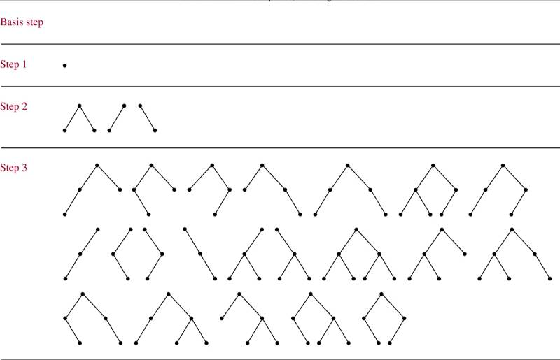
Extended Binary Trees
∅

Slide 47
Full Binary Trees
Definition: The set of full binary trees can be defined recursively by:
Basis step: There is a full binary tree consisting only of a single vertex r.
Recursive step: If T₁ and T₂ are disjoint full binary trees, there is a full binary tree, denoted by T₁ · T₂, consisting of a root r together with edges connecting the root to each of the roots of the left subtree T₁ and the right subtree T₂.
Note: T₁ and T₂ cannot be empty sets.

Slide 48
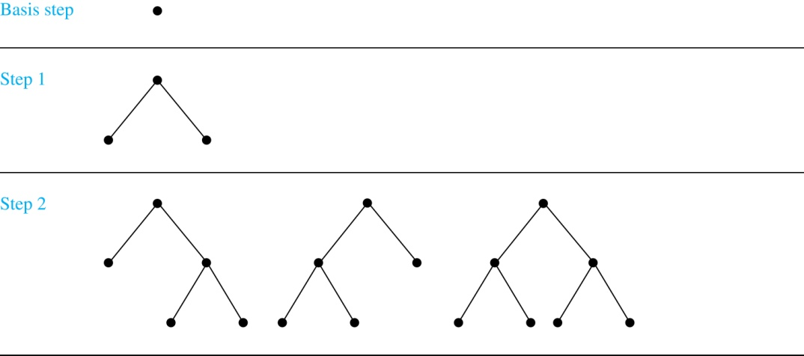
Full Binary Trees

Slide 49
Induction and Recursively Defined Sets
Example: Show that the set S defined by specifying that 3 ∊ S and that if x ∊ S and y ∊ S, then x + y is in S, is the set of all positive integers that are multiples of 3.
Solution: Let A be the set of all positive integers divisible by 3. To prove that A = S, show that A ⊆ S and S ⊆ A.
A⊆ S: Let P(n) be the statement that 3n ∊ S.
BASIS STEP: By the recursive definition, we have 3∙1 = 3 ∊ S.
INDUCTIVE STEP: Assume P(k) is true, i.e., 3k ∊ S. Because 3k ∊ S and 3 ∊ S, it follows from the recursive definition that 3k + 3 = 3(k + 1) ∊ S, i.e., P(k + 1) is true.
S ⊆ A:
BASIS STEP: By the recursive definition, 3 ∊ S. Because 3 = 3∙1, we have 3 ∊ A.
INDUCTIVE STEP: Whenever x ∊ S and y ∊ S, we have x + y ∊ S by the recursive definition. Suppose that x ∊ S and y ∊ S. Assume that x ∊ A and y ∊ A, i.e., 3 | x and 3 | y. By Theorem 1 of Section 4.1, it follows that 3 | x + y., i.e., x + y ∊ A.

Slide 50
Structural Induction
To prove a property of the elements of a recursively defined set, we use structural induction.
BASIS STEP: Show that the result holds for all elements specified in the basis step of the recursive definition.
RECURSIVE STEP: Show that if the statement is true for each of the elements used to construct new elements in the recursive step of the definition, the result holds for these new elements.
The validity of structural induction can be shown to follow from the principle of mathematical induction.

Slide 51
Structural Induction
Definition: The height h(T) of a full binary tree T is defined recursively as follows:
BASIS STEP: The height of a full binary tree T consisting of only a root r is h(T) = 0.
RECURSIVE STEP: If T₁ and T₂ are full binary trees, then the full binary tree T = T₁∙T₂ has height h(T) = 1 + max(h(T₁),h(T₂)).
Definition: The number of vertices n(T) of a full binary tree T satisfies the following recursive formula:
BASIS STEP: The number of vertices of a full binary tree T consisting of only a root r is n(T) = 1.
RECURSIVE STEP: If T₁ and T₂ are full binary trees, then the full binary tree T = T₁∙T₂ has the number of vertices n(T) = 1 + n(T₁) + n(T₂).

Slide 52
Structural Induction
Theorem: If T is a full binary tree, then n(T) ≤ 2^{h(T)+1} – 1.
Proof: Use structural induction.
BASIS STEP: The result holds for a full binary tree consisting only of a root, n(T) = 1 and h(T) = 0. Hence, n(T) = 1 ≤ 2⁰⁺¹ – 1 = 1.
RECURSIVE STEP: Assume n(T₁) ≤ 2^{h(T1)+1} – 1 and n(T₂) ≤ 2^{h(T2)+1} – 1 whenever T₁ and T₂ are full binary trees.
n(T) = 1 + n(T₁) + n(T₂) (by recursive formula of n(T))
≤ 1 + (2^{h(T1)+1} – 1) + (2^{h(T2)+1} – 1) (by inductive hypothesis)
≤ 2∙max(2^{h(T1)+1} ,2^{h(T2)+1} ) – 1
= 2∙2^{max(h(T1),h(T2))+1} – 1 (max(2^{x} , 2^{y})= 2^{max(x,y)} )
= 2∙2^{h(T)} – 1 (by recursive definition of h(T))
= 2^{h(T)+1} – 1

